Slide 1
EEG&EOG-based Sleep Staging
CS 182 Project
Hu Gangfeng
Teng Zhihao
Qin Chao

Slide 2
Content
Research Background
Status-of-art about Sleep-staging
Database
Classification Models
Research Pipeline
Evaluation
Improvement and innovation

Slide 3
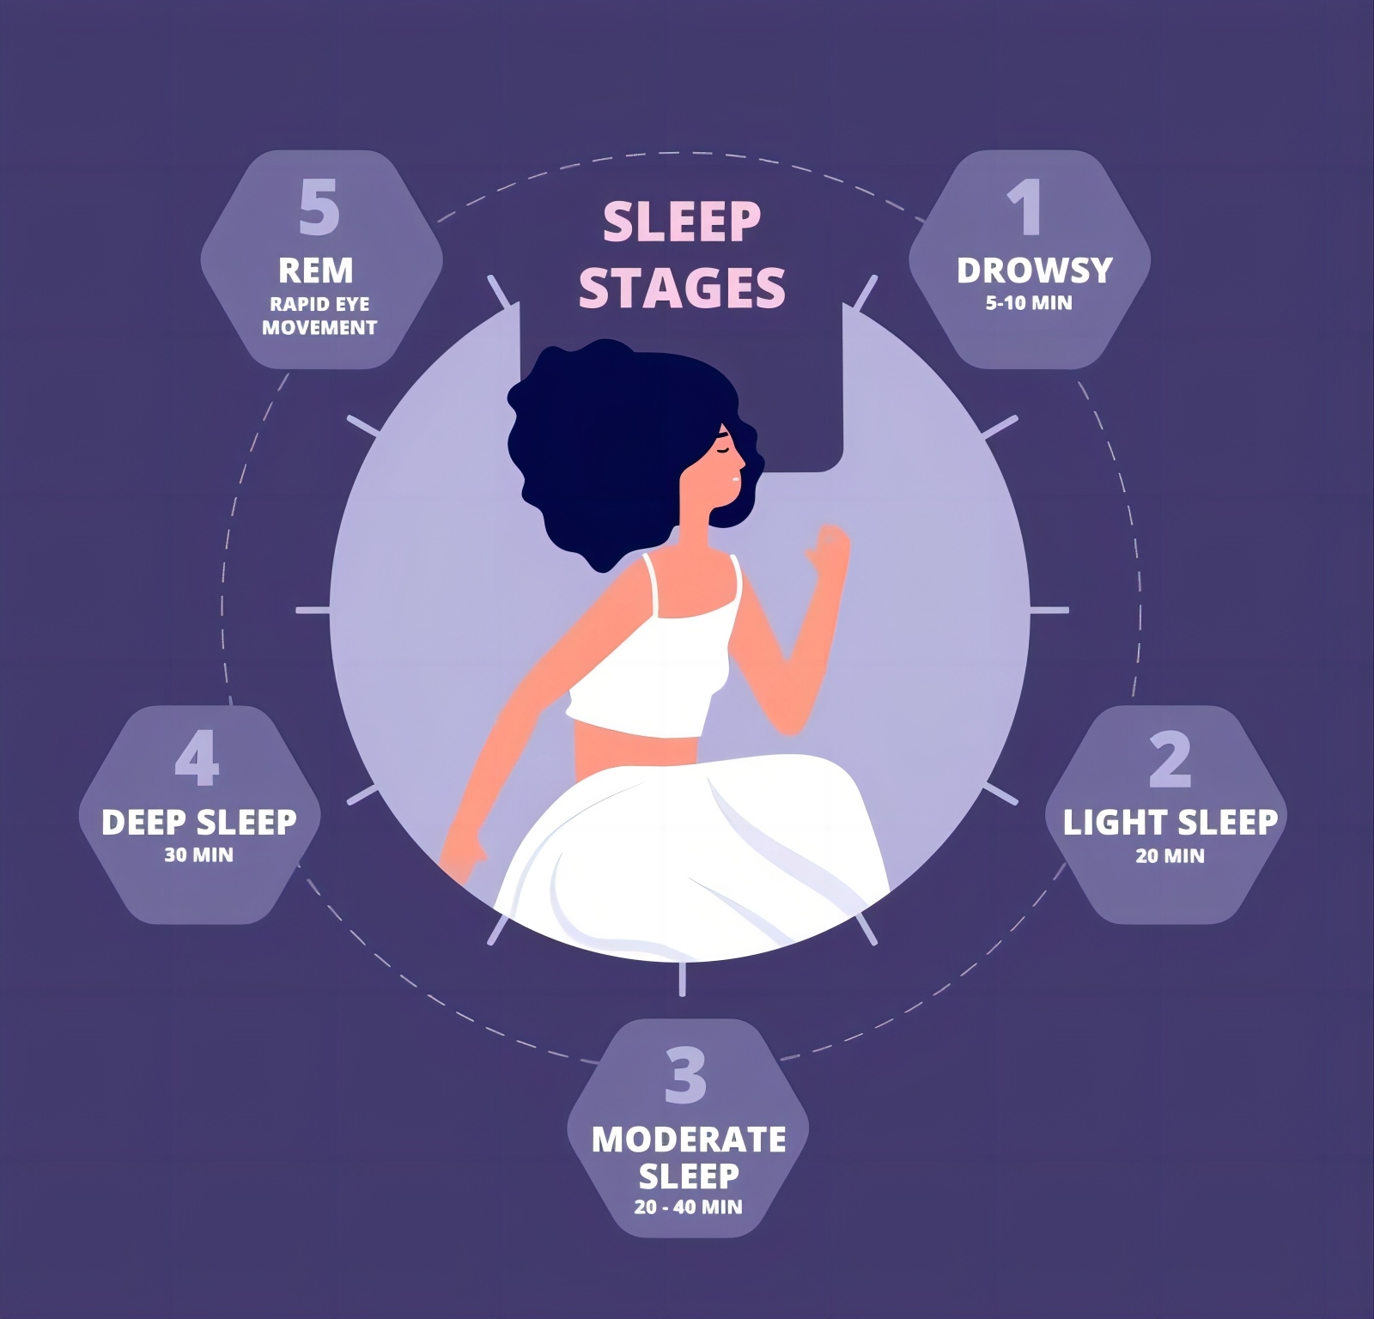
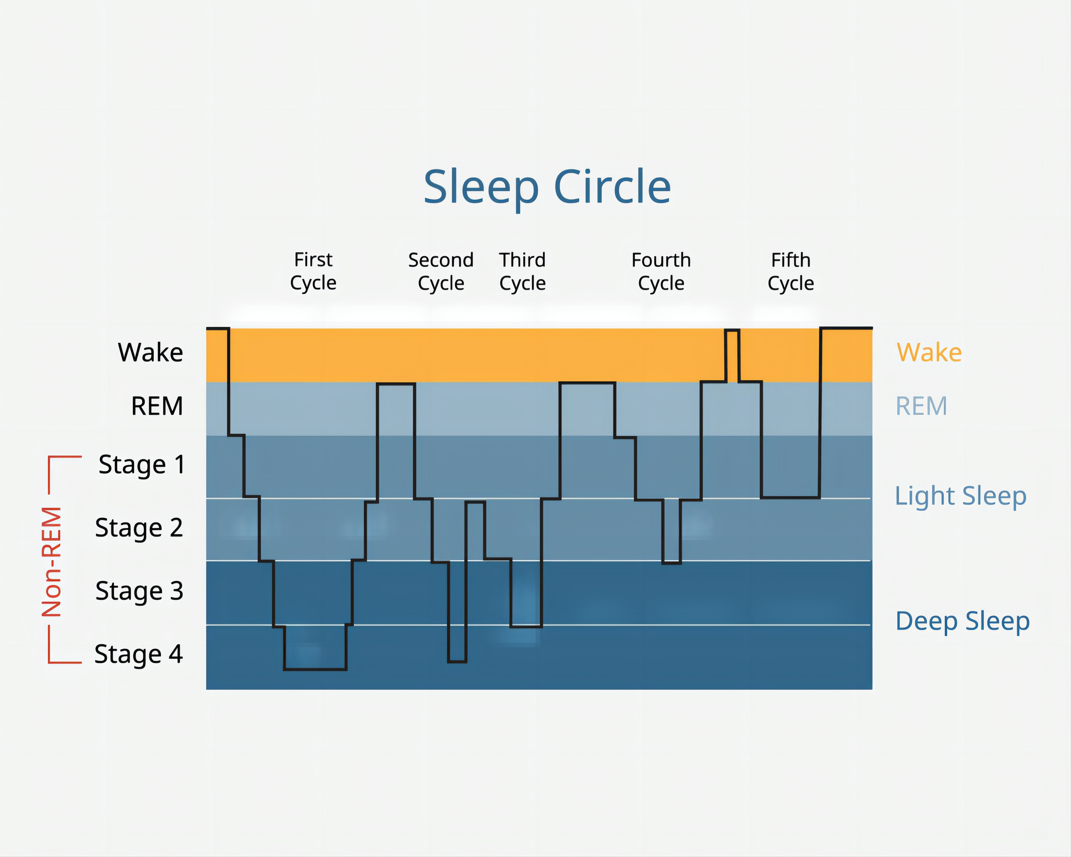
Research Background
Crucial for understanding sleep patterns and overall health.
5 Sleep Stages: non-rapid eye movement (NREM:N1, N2, N3, N4) and rapid eye movement (REM) sleep

Slide 4
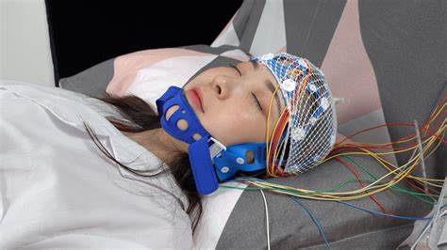
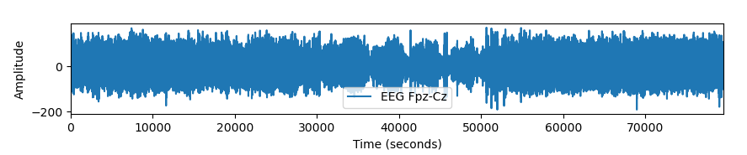
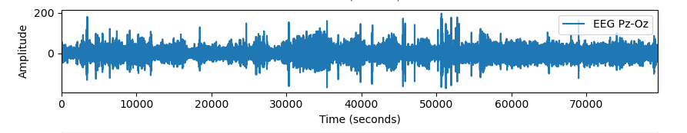
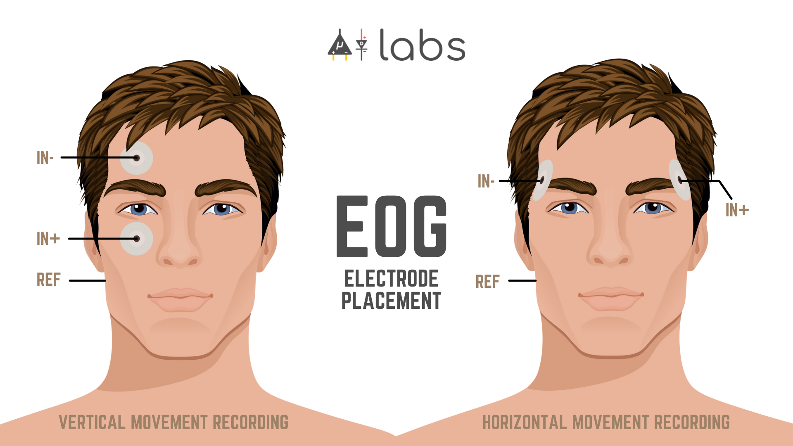
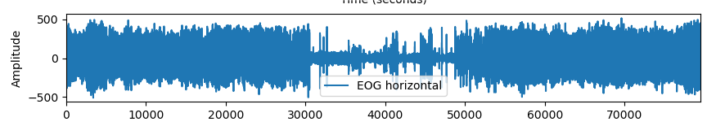
Research Background
EEG (Electroencephalogram): measuring brain activities
EOG (Electrooculography): measuring eye movements
Sleep stage can be classified based on EEG + EOG signals.
Frontopolar + Central zero
Parietal + Occipital
Fig. 1 A subject undergoing EEG monitoring
Fig. 2 Explanation to EOG

Slide 5
Status-of-art about Sleep-staging
Mainly focused on developing increasingly complex deep learning architectures^{[1]}
Year | System | Technique | ACC
2021 | XSleepnet2^{[1]} | CNN & RNN | 0.864
2019 | SleepEEGNet^{[2]} | CNN & RNN | 0.843
2020 | DeepSleepNet+^{[3]} | CNN | 0.846
2022 | SleepTransformer^{[4]} | transformer | 0.849
lack of inter-
-pretability and transparency
Do not have ideal accuracy
[1] Phan, H., Ch´en, O.Y., Tran, M.C., Koch, P., Mertins, A., De Vos, M.: Xsleepnet: Multi-view sequential model for automatic sleep staging. IEEE Transactions on Pattern Analysis and Machine Intelligence (2021)
[2] Mousavi, S., Afghah, F., Acharya, U.R.: Sleepeegnet: Automated sleep stage scoring with sequence to sequence deep learning approach. PloS one 14(5), e0216456(2019)
[3] Phan, H., Ch´en, O.Y., Koch, P., Lu, Z., McLoughlin, I., Mertins, A., De Vos, M.: Towards more accurate automatic sleep staging via deep transfer learning. IEEE Transactions on Biomedical Engineering 68(6), 1787–1798 (2020)
[4] Phan, H., Mikkelsen, K.B., Chen, O., Koch, P., Mertins, A., De Vos, M.: Sleep transformer: Automatic sleep staging with interpretability and uncertainty quantification. IEEE Transactions on Biomedical Engineering (2022)

Slide 6
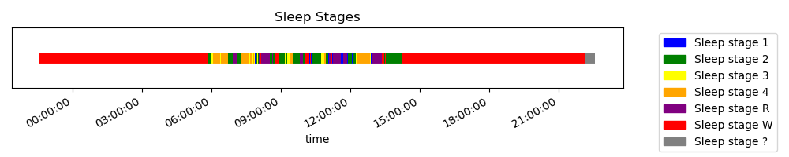
Database
Public Data Set^{[5]}: 152 patients, continuous sleep signals
provide EEG and EOG signals during patients’ sleeping
provide sleep stages at each time
Fig. 1 EOG signal in dataset
Fig. 2 EEG signal in dataset
Wake
[5] https://www.physionet.org/content/sleep-edfx/1.0.0/

Slide 7
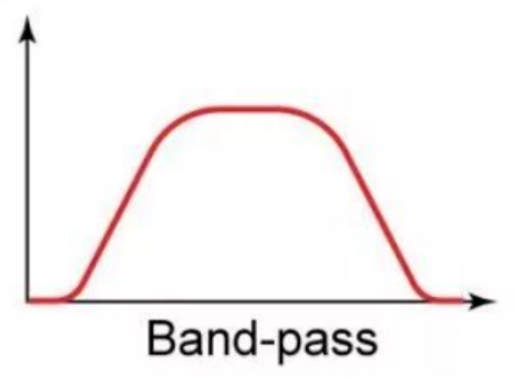
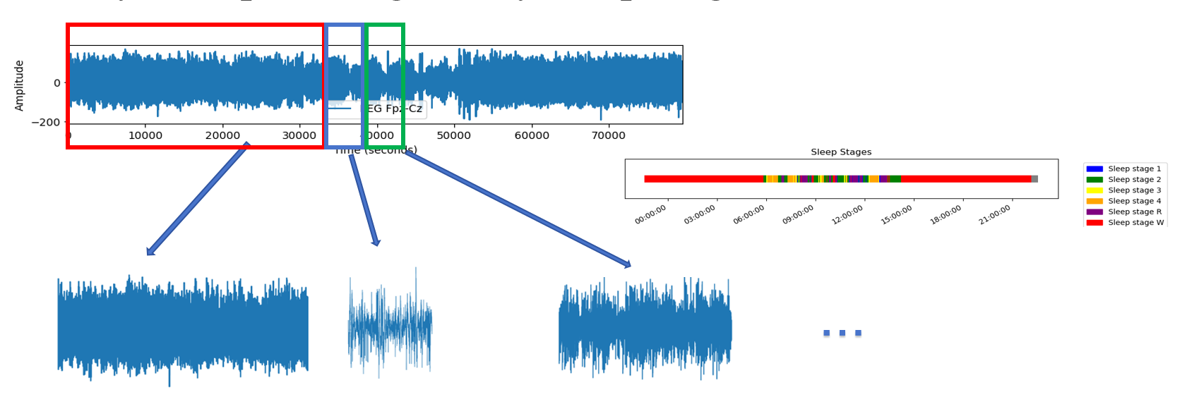
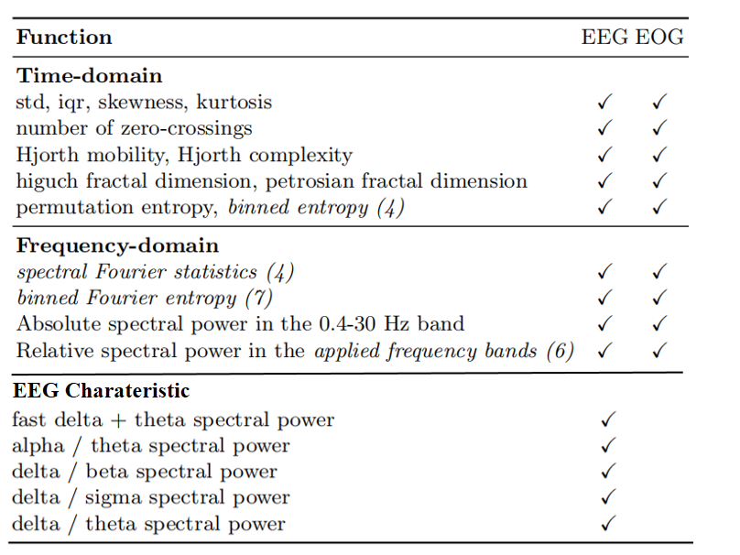
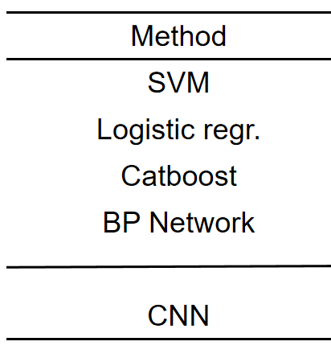
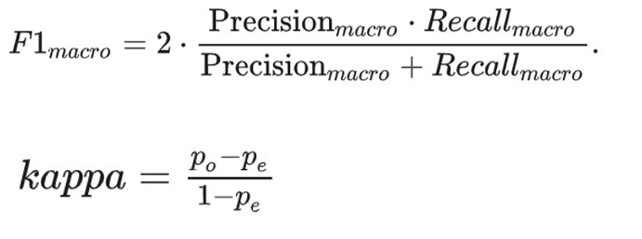
Research Pipeline
Preprocessing
Signal-spliting
Dataset
Feature
Extraction
Model Evaluation
Classification based on ML/DL

Slide 8
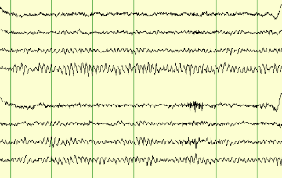
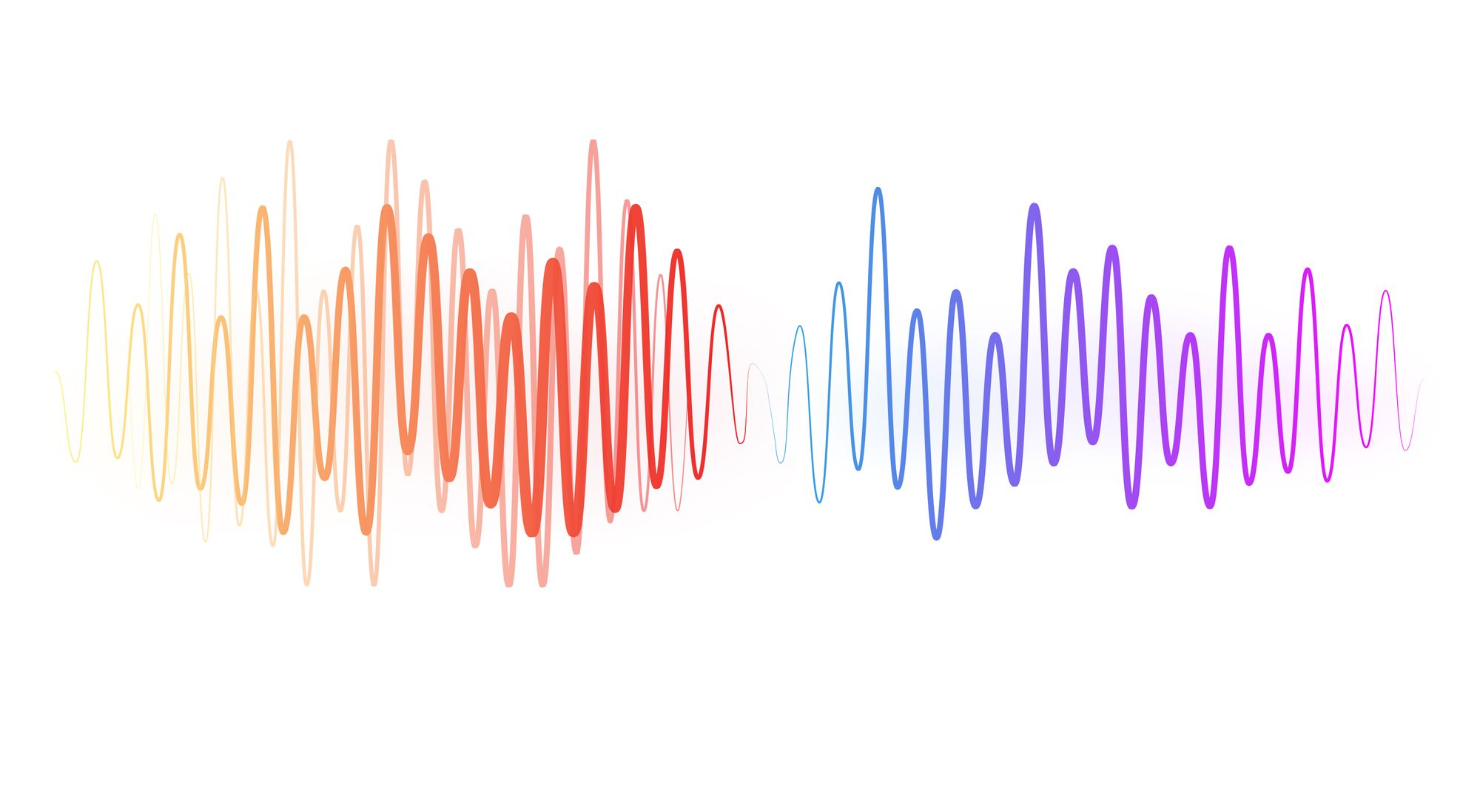
Preprocessing
0.4~30 Hz
removing artifacts or noise
Signal without Noise
0.4~30 Hz: Clinically meaningful frequencies of sleep-wave patterns.^{[6]}
[6] Malhotra, A., Younes, M., Kuna, S.T., Benca, R., Kushida, C.A., Walsh, J.Hanlon, A., Staley, B., Pack, A.I., Pien, G.W.: Performance of an automated polysomnography scoring system versus computer-assisted manual scoring. Sleep 36(4), 573–582 (2013)

Slide 9
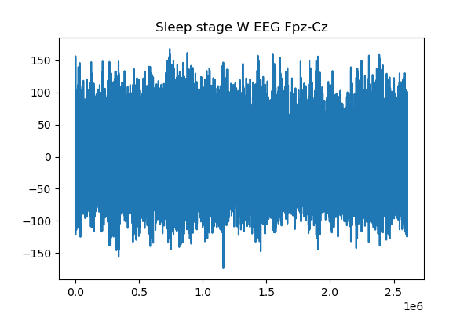
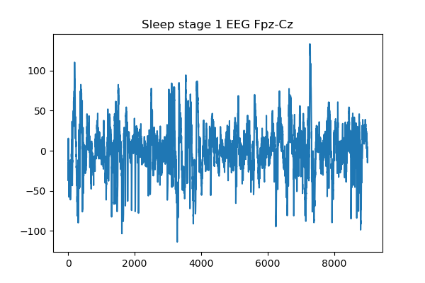
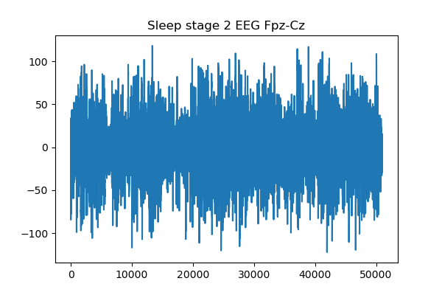
Preprocessing
Firstly, we splited signals by sleep stages
...

Slide 10
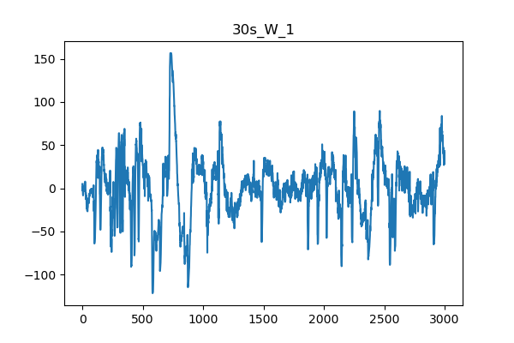
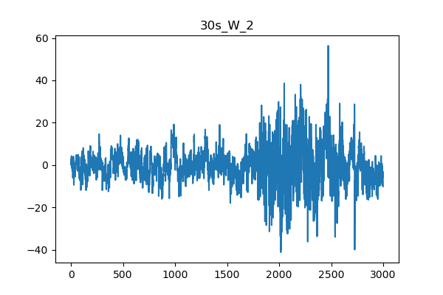
signal spliting
We prefer to identify signals with same length
splited the raw signal by 30s.
...
...
Fs=100 Hz

Slide 11
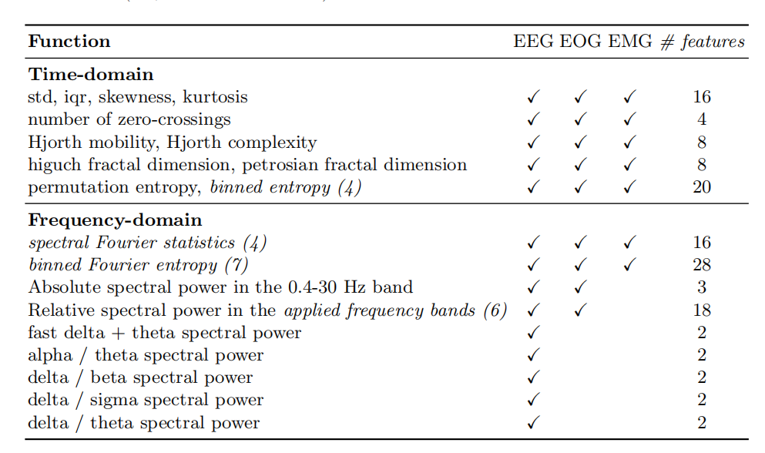
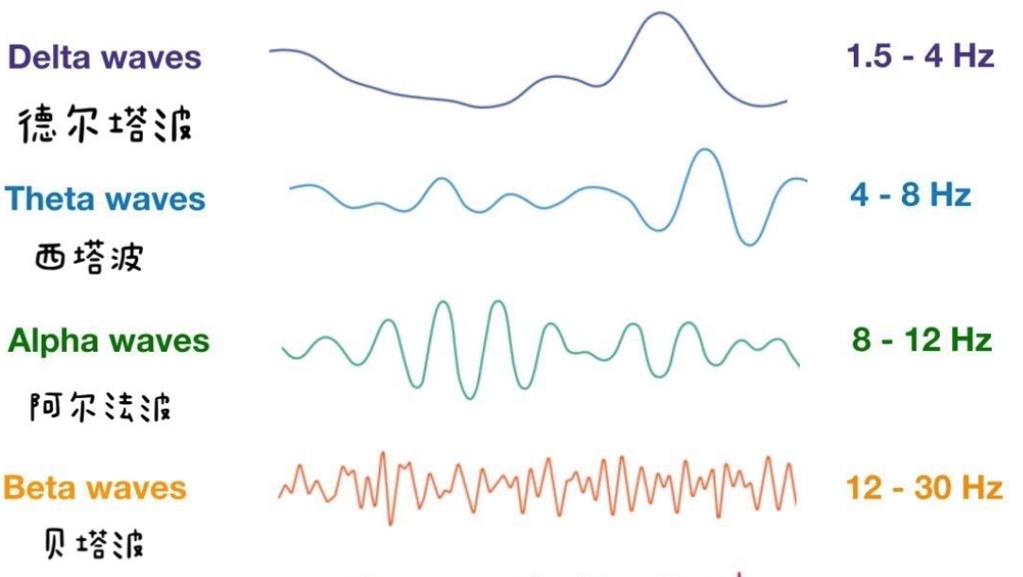
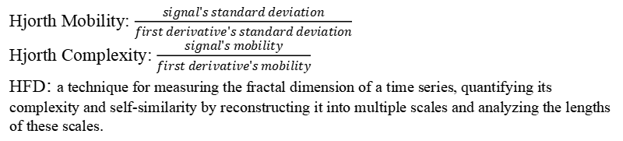
Feature Extraction
Multi-domain features:
Time-domain features
Frequency-domain features
EEG Charateristic
EEG Charateristic
Hjorth Mobility: $\frac{signal's standard deviation}{first derivative's standard deviation}$
Hjorth Complexity: $\frac{signal's mobility}{first derivative's mobility}$
HFD: a technique for measuring the fractal dimension of a time series, quantifying its complexity and self-similarity by reconstructing it into multiple scales and analyzing the lengths of these scales.

Slide 12
Feature Extraction
We used PCA to reduce the dimension:393345×82
Retaining
393345
×46
393345×105
Retaining
393345 × 105
393345×82
393345 × 82
99.9%
Variance
95%
Variance
Feature Matrix
Matrices after PCA

Slide 13
Classification Model
Based on Machine Learning and Deep Learning:
Method | Accuracy in Paper | Accuracy We Get
SVM | not mentioned | 0.78
Logistic regr. | 0.863 | 0.878
Catboost | 0.864 | Under Construction
BP Network | not mentioned | Under Construction
CNN | 0.840 | Under Construction

Slide 14
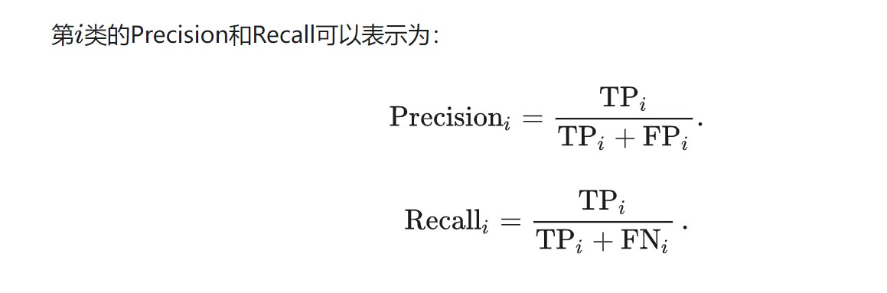
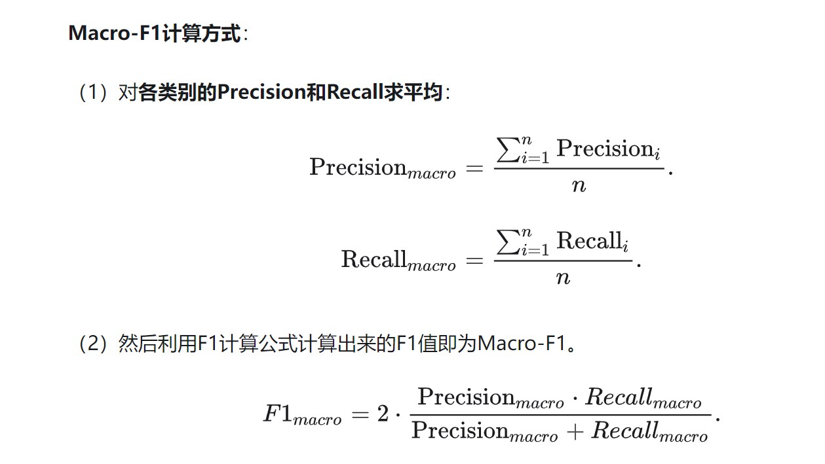
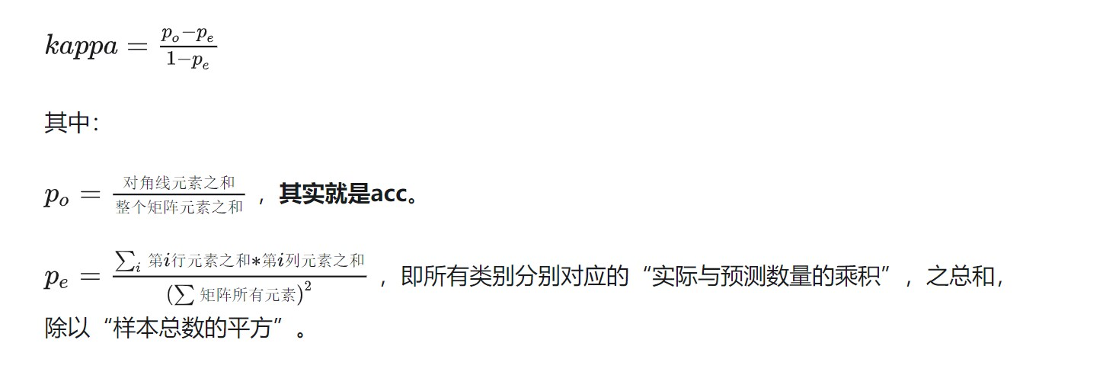
Model Evaluation
Strategy: Cross-Validation (10-folder validation)
Metric: ACC, Macro-F1, κ

Slide 15
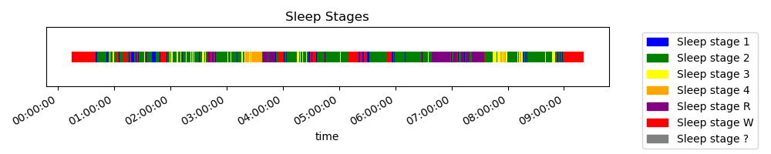
Improvement and innovation
Consider the characteristic of sleep stages:
Wake
Notice that “Sleep stage 3” appears more esaily after “Sleep stage 2”, while “Sleep stage 1” appears more esaily after “Wake”...
Probabilistic graphical model or Markov Model can be used to help detect sleep stages in continuous sleeping signals.
RNN may be good to solve continuous sleeping signals.

